Slide 1
Rock Crawler

Slide 2
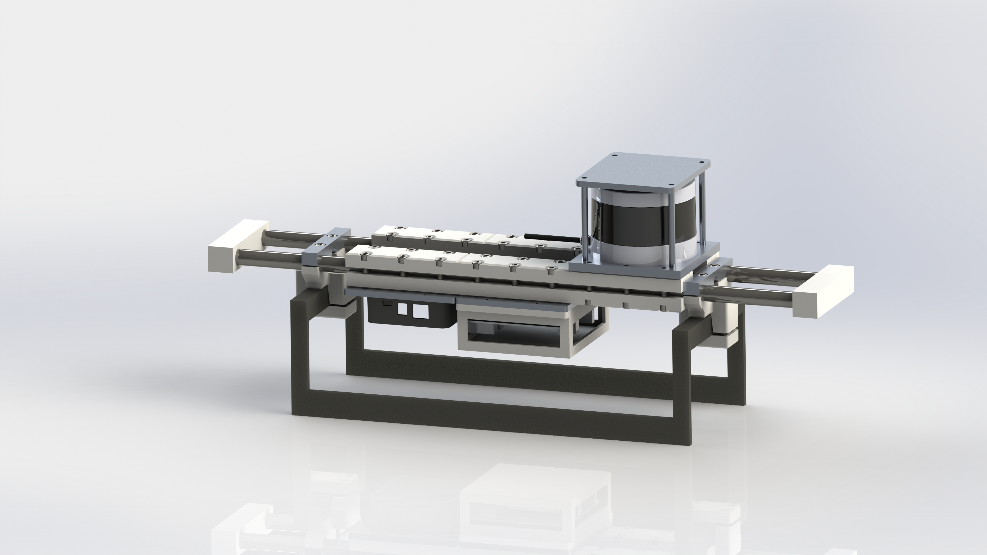
Mechanical Design:
Sensor Package: Rigidly connected set modules containing the lidar, cameras, computer, and IMU (Maybe also motor driver?)
Chassis Clamps: Attach Sensor Package to Car chassis.

Slide 3
Electrical Architectures:
Goals (Short Term):
Closed loop speed control.
ROS compatible interface.
Goals (Medium Term):
Wheel Odometery.
Closed loop turning.
Battery Monitoring.
Goals (Long Term):
Suspension sensors?
Fault Detection?
Possible Solutions:
Nano -> PCA9685 -> Speed Controller
Inexpensive.
Robust.
Imprecise at low speeds.
Teensy -> O-Drive
Precise at low speeds.
Low-Medium peak power.
Low minimum voltage (24v).
Elmo
Expensive?
High Current, High Voltage.
Versatile feedback options.

Slide 4
Encoder Options
Self-Contained:
Hard to mount.
Robust.
Requires modifying chassis.
Snap-on-Shaft:
Hard to mount.
Possibly Delicate.
Magnetic (external):
Mounts out of plane.
Low Resolution.
Requires post-processing?

Slide 5
System Diagrams
O-Drive
PCA9685
NUC
Teensy
O-drive
NUC
Nano
PCA9685
Speed
Controller
Encoder
Encoder

Slide 6
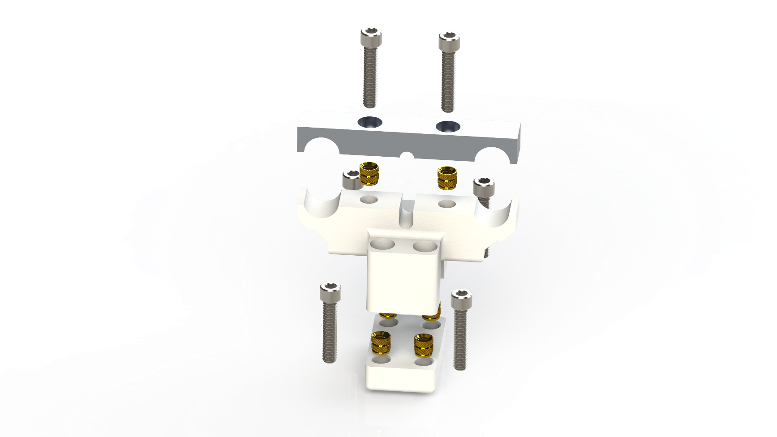
Chassis Clamps

